Slide 1
Module #17:
Recurrence Relations
26年 11月 8日
©2001-2004 Michael P. Frank, revised by S. Kang

Slide 2
§6.1: Recurrence Relations
A recurrence relation (R.R., or just recurrence) for a sequence {a_{n}} is an equation that expresses a_{n} in terms of one or more previous elements
a₀, …, a_{n−1} of the sequence, for all n≥n₀.
  I.e., just a recursive definition, without the base cases.
A particular sequence (described non-recursively) is said to solve the given recurrence relation if it is consistent with the definition of the recurrence.
  A given recurrence relation may have many solutions.
26年 11月 8日
©2001-2004 Michael P. Frank, revised by S. Kang

Slide 3
Recurrence Relation Example
Consider the recurrence relation
a_{n} = 2a_{n−1} − a_{n−2} (n≥2).
Which of the following are solutions?
a_{n} = 3n
a_{n} = 2^{n}
a_{n} = 5
Yes
No
Yes
26年 11月 8日
©2001-2004 Michael P. Frank, revised by S. Kang

Slide 4
Example Applications
Recurrence relation for growth of a bank account with P% interest per given period:
M_{n} = M_{n−1} + (P/100)M_{n−1}
Growth of a population in which each organism yields 1 new one every period starting 2 time periods after its birth.
P_{n} = P_{n−1} + P_{n−2} (Fibonacci relation)
26年 11月 8日
©2001-2004 Michael P. Frank, revised by S. Kang

Slide 5
Solving Compound Interest RR
M_{n} = M_{n−1} + (P/100)M_{n−1}
= (1 + P/100) M_{n−1}
= r M_{n−1} (let r = 1 + P/100)
= r (r M_{n−2})
= r·r·(r M_{n−3}) …and so on to…
= r^{n} M₀
26年 11月 8日
©2001-2004 Michael P. Frank, revised by S. Kang

Slide 6
Tower of Hanoi Example
Problem: Get all disks from peg 1 to peg 2.
  Rules: (a) Only move 1 disk at a time.
  (b) Never set a larger disk on a smaller one.
Peg #1
Peg #2
Peg #3
26年 11月 8日
©2001-2004 Michael P. Frank, revised by S. Kang
Notes:
Discrete Mathematics and its Applications
26年 11月 8日
(c)2001-2002, Michael P. Frank
Instructor can solve the puzzle interactively by dragging the disks around.

Slide 7
Hanoi Recurrence Relation
Let H_{n} = # moves for a stack of n disks.
Here is the optimal strategy:
  Move top n−1 disks to spare peg. (H_{n−1} moves)
  Move bottom disk. (1 move)
  Move top n−1 to bottom disk. (H_{n−1} moves)
Note that: H_{n} = 2H_{n−1} + 1
  The # of moves is described by a Rec. Rel.
26年 11月 8日
©2001-2004 Michael P. Frank, revised by S. Kang

Slide 8
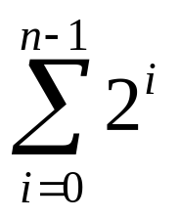
Solving Tower of Hanoi RR
H_{n} = 2 H_{n−1} + 1
= 2 (2 H_{n−2} + 1) + 1 = 2² H_{n−2} + 2 + 1
= 2²(2 H_{n−3} + 1) + 2 + 1 = 2³ H_{n−3} + 2² + 2 + 1
…
= 2^{n−1} H₁ + 2^{n−2} + … + 2 + 1
= 2^{n−1} + 2^{n−2} + … + 2 + 1 (since H₁ = 1)
=
= 2^{n} − 1
26年 11月 8日
©2001-2004 Michael P. Frank, revised by S. Kang

Slide 9
Another R.R. Example
Find a R.R. & initial conditions for the number of bit strings of length n without two consecutive 0s.
We can solve this by breaking down the strings to be counted into cases that end in 0 and in 1.
  For each ending in 0, the previous bit must be 1, and before that comes any qualifying string of length n−2.
  For each string ending in 1, it starts with a qualifying string of length n−1.
Thus, a_{n} = a_{n−1} + a_{n−2}. (Fibonacci recurrence.)
  The initial conditions are: a₀ = 1 (ε), a₁ = 2 (0 and 1).
(n−2 bits)
1
0
(n−1 bits)
1
26年 11月 8日
©2001-2004 Michael P. Frank, revised by S. Kang

Slide 10
§6.2: Solving Recurrences
General Solution Schemas
A linear homogeneous recurrence of degree k with constant coefficients
(“k-LiHoReCoCo”) is a rec. rel. of the form
a_{n} = c₁a_{n−1} + … + c_{k}a_{n−k},
where the c_{i} are all real, and c_{k} ≠ 0.
The solution is uniquely determined if k initial conditions a₀…a_{k−1} are provided.
26年 11月 8日
©2001-2004 Michael P. Frank, revised by S. Kang

Slide 11
Solving LiHoReCoCos
Basic idea: Look for solutions of the form a_{n} = r^{n}, where r is a constant.
This requires solving the characteristic equation:
r^{n} = c₁r^{n−1} + … + c_{k}r^{n−k}, i.e.,
r^{k} − c₁r^{k−1} − … − c_{k} = 0
The solutions r to this equation are called the characteristic roots of the LiHoReCoCo.
  They can yield an explicit formula for the sequence.
(rearrange
& × by r^{k−n})
26年 11月 8日
©2001-2004 Michael P. Frank, revised by S. Kang

Slide 12
Solving 2-LiHoReCoCos
Consider an arbitrary 2-LiHoReCoCo:
a_{n} = c₁a_{n−1} + c₂a_{n−2}
It has the characteristic equation (C.E.):
r² − c₁r − c₂ = 0
Theorem 1: If the CE has 2 roots r₁≠r₂, then the solutions to the RR are given by:
a_{n} = α₁r₁^{n} + α₂r₂^{n} for n≥0
for any and all constants α₁, α₂.
Special case: a_{n} = r₁^{n} and a_{n} = r₂^{n} are, of course, solutions.
26年 11月 8日
©2001-2004 Michael P. Frank, revised by S. Kang

Slide 13
Proof of Theorem 1
Proof that a_{n} = α₁r₁^{n}+α₂r₂^{n} is always a solution:
  We know r₁² = c₁r₁ + c₂ and r₂² = c₁r₂ + c₂.
  Now we can show the proposed sequence satisfies the recurrence a_{n} = c₁a_{n−1} + c₂a_{n−2}:
c₁a_{n−1} + c₂a_{n−2} = c₁(α₁r₁^{n−1}+α₂r₂^{n−1}) + c₂(α₁r₁^{n−2}+α₂r₂^{n−2})
= α₁r₁^{n−2}(c₁r₁+c₂) + α₂r₂^{n−2}(c₁r₂+c₂)
= α₁r₁^{n−2}r₁² + α₂r₂^{n−2}r₂² = α₁r₁^{n} + α₂r₂^{n} = a_{n}. □
Can complete the proof by showing that for any initial conditions, we can find corresponding α’s.
  But it turns out this goes through only if r₁≠r₂.
26年 11月 8日
©2001-2004 Michael P. Frank, revised by S. Kang

Slide 14
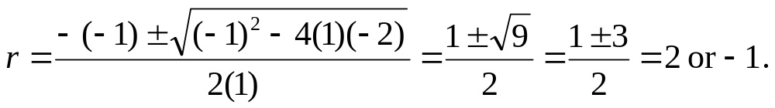
Example
Solve the recurrence a_{n} = a_{n−1} + 2a_{n−2} given the initial conditions a₀ = 2, a₁ = 7.
Solution: Use theorem 1:
  We have c₁ = 1, c₂ = 2
  The characteristic equation is: r² − r − 2 = 0
  Solve it:
  so, r = 2 or r = −1.
  So, a_{n} = α₁ 2^{n} + α₂ (−1)^{n}.
26年 11月 8日
©2001-2004 Michael P. Frank, revised by S. Kang

Slide 15
Example Continued…
To find α₁ and α₂, just solve the equations for the initial conditions a₀ and a₁:
a₀ = 2 = α₁2⁰ + α₂ (−1)⁰
a₁ = 7 = α₁2¹ + α₂ (−1)¹
Simplifying, we have the pair of equations:
2 = α₁ + α₂
7 = 2α₁ − α₂
which we can solve easily by substitution:
α₂ = 2−α₁; 7 = 2α₁ − (2−α₁) = 3α₁ − 2;
9 = 3α₁; α₁ = 3; α₂ = −1.
Using α₁ and α₂, our final answer is: a_{n} = 3·2^{n} − (−1)^{n}
Check: {a_{n≥0}} = 2, 7, 11, 25, 47, 97 …
26年 11月 8日
©2001-2004 Michael P. Frank, revised by S. Kang

Slide 16
The Case of Degenerate Roots
Now, what if the C.E. r² − c₁r − c₂ = 0 has only 1 root r₀?
Theorem 2: Then,
a_{n} = α₁r₀^{n} + α₂nr₀^{n}, for all n≥0,
for some constants α₁, α₂.
26年 11月 8日
©2001-2004 Michael P. Frank, revised by S. Kang

Slide 17
Degenerate Root Example
Solve a_{n} = 6a_{n−1}−9a_{n−2} with a₀=1, a₁=6.
The C.E. is: r²−6r+9=0.
  Therefore, there is only one root, namely 3
Hence, by Theorem 2, a_{n} = α₁3^{n} + α₂n3^{n}
  a₀ = 1 = α₁
  a₁ = 6 = α₁3 + α₂3 = 3 + 3α₂, α₂ = 1
  a_{n} = 3^{n} + n3^{n} = (1+n)3^{n}
26年 11月 8日
©2001-2004 Michael P. Frank, revised by S. Kang

Slide 18
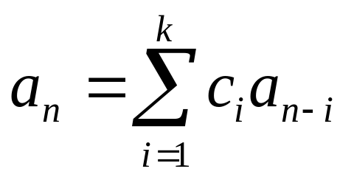
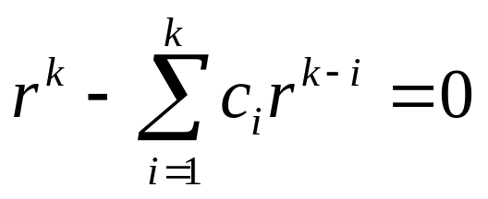
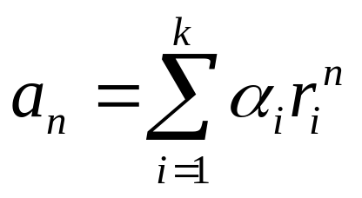
k-LiHoReCoCos
Consider a k-LiHoReCoCo:
It’s C.E. is:
Theorem 3: If this has k distinct roots r_{i}, then the solutions to the recurrence are of the form:
for all n≥0, where the α_{i} are constants.
26年 11月 8日
©2001-2004 Michael P. Frank, revised by S. Kang

Slide 19
LiNoReCoCos
Linear nonhomogeneous RRs with constant coefficients may (unlike LiHoReCoCos) contain some terms F(n) that depend only on n (and not on any a_{i}’s). General form:
a_{n} = c₁a_{n−1} + … + c_{k}a_{n−k} + F(n)
The associated homogeneous recurrence relation
(associated LiHoReCoCo).
26年 11月 8日
©2001-2004 Michael P. Frank, revised by S. Kang

Slide 20
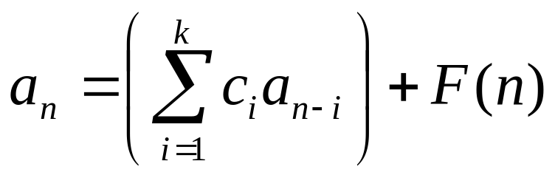
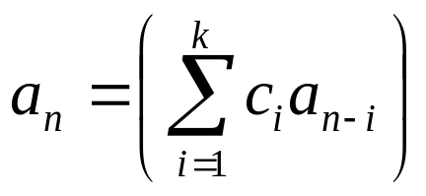
Solutions of LiNoReCoCos
A useful theorem about LiNoReCoCos:
  If a_{n} = p(n) is any particular solution to the LiNoReCoCo:
  Then all of its solutions are of the form:
  a_{n} = p(n) + h(n),
  where a_{n} = h(n) is any solution to the associated homogeneous RR
26年 11月 8日
©2001-2004 Michael P. Frank, revised by S. Kang

Slide 21
LiNoReCoCo Example
Find all solutions to a_{n} = 3a_{n−1}+2n. Which solution has a₁ = 3?
  Notice this is a 1-LiNoReCoCo. Its associated 1-LiHoReCoCo is a_{n} = 3a_{n−1}, whose solutions are all of the form a_{n} = α3^{n}. Thus the solutions to the original problem are all of the form
  a_{n} = p(n) + α3^{n}. So, all we need to do is find one p(n) that works.
26年 11月 8日
©2001-2004 Michael P. Frank, revised by S. Kang

Slide 22
Trial Solutions
If the extra terms F(n) are a degree-t polynomial in n, you should try a general degree-t polynomial as the particular solution p(n).
This case: F(n) is linear so try a_{n} = cn + d.
cn+d = 3(c(n−1)+d) + 2n (for all n)
(2c+2)n + (2d−3c) = 0 (collect terms)
So c = −1 and d = −3/2.
So a_{n} = −n − 3/2 is a solution.
Check: a_{n≥1} = {−5/2, −7/2, −9/2, … }
26年 11月 8日
©2001-2004 Michael P. Frank, revised by S. Kang
Notes:
Discrete Mathematics and its Applications
26年 11月 8日
(c)2001-2002, Michael P. Frank

Slide 23
Finding a Desired Solution
From the previous, we know that all general solutions to our example are of the form:
a_{n} = −n − 3/2 + α3^{n}.
Solve this for α for the given case, a₁ = 3:
3 = −1 − 3/2 + α3¹
α = 11/6
The answer is a_{n} = −n − 3/2 + (11/6)3^{n}.
26年 11月 8日
©2001-2004 Michael P. Frank, revised by S. Kang

Slide 24
Double Check Your Answer!
Check the base case, a₁=3:
  a_{n} = −n − 3/2 + (11/6)3^{n}
  a₁ = −1 − 3/2 + (11/6)3¹
  = −2/2 − 3/2 + 11/2 = −5/2 + 11/2 = 6/2 = 3
Check the recurrence, a_{n} = 3a_{n−1}+2n:
  3[−(n−1) − 3/2 + (11/6)3^{n−1}]+2n
  = 3[−n − 1/2 + (11/6)3^{n−1}] + 2n
  = −3n − 3/2 + (11/6)3^{n} + 2n = −n − 3/2 + (11/6)3^{n} = a_{n} ■
26年 11月 8日
©2001-2004 Michael P. Frank, revised by S. Kang

Slide 25
§6.3: Divide & Conquer R.R.s
Many types of problems are solvable by reducing a problem of size n into some number a of independent subproblems, each of size ≤ ⎡n/b⎤, where a≥1 and b>1.
The time complexity to solve such problems is given by a recurrence relation:
  T(n) = a·T(⎡n/b⎤) + g(n)
Time to break problem
up into subproblems
Time for each subproblem
26年 11月 8日
©2001-2004 Michael P. Frank, revised by S. Kang

Slide 26
Divide+Conquer Examples
Binary search:
  Reduce problem to 1 sub-problem (namely, searching half of the list) of size ≤ ⎡n/2⎤
  thus, a=1 and b=2
  So T(n) = T(⎡n/2⎤)+c (g(n)=c, a constant)
26年 11月 8日
©2001-2004 Michael P. Frank, revised by S. Kang

Slide 27
Fast Multiplication Example
The ordinary grade-school algorithm takes Θ(n²) steps to multiply two n-digit numbers.
  Seems like too much work!
Let’s find an asymptotically faster algorithm!
To find the product cd of two 2n-digit base-b numbers, c=(c_{2n-1}c_{2n-2}…c₀)_{b} and
d=(d_{2n-1}d_{2n-2}…d₀)_{b}: first, we break c and d in half:
c=b^{n}C₁+C₀, d=b^{n}D₁+D₀,
and then... (see next slide)
26年 11月 8日
©2001-2004 Michael P. Frank, revised by S. Kang

Slide 28
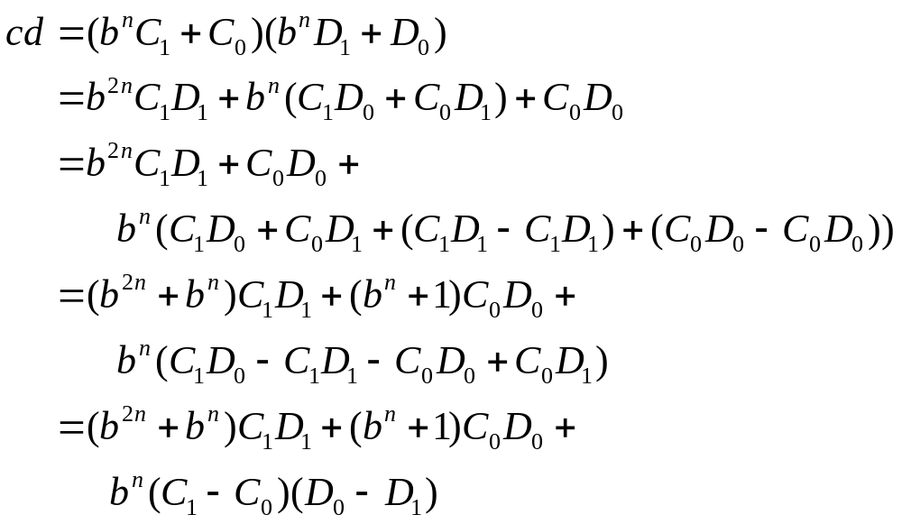
Derivation of Fast Multiplication
(Multiply out
polynomials)
Zero
(Factor last term)
Three multiplications, each with n-digit numbers
26年 11月 8日
©2001-2004 Michael P. Frank, revised by S. Kang

Slide 29
Recurrence Rel. for Fast Mult.
Notice that the time complexity T(n) of the fast multiplication algorithm obeys the recurrence:
T(2n)=3T(n)+Θ(n)
i.e.,
T(n)=3T(n/2)+Θ(n)
So a=3, b=2.
Time to do the needed adds &
subtracts of n-digit and 2n-digit
numbers
26年 11月 8日
©2001-2004 Michael P. Frank, revised by S. Kang

Slide 30
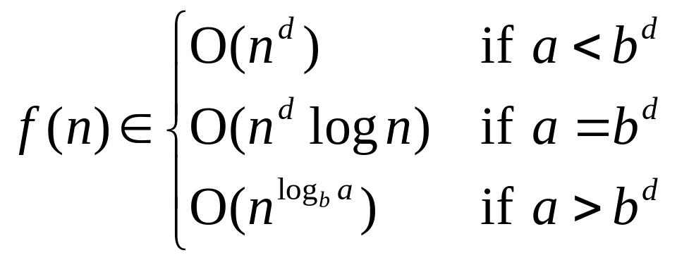
The Master Theorem
Consider a function f(n) that, for all n=b^{k} for all k∈Z⁺,,satisfies the recurrence relation:
f(n) = af(n/b) + cn^{d}
with a≥1, integer b>1, real c>0, d≥0. Then:
26年 11月 8日
©2001-2004 Michael P. Frank, revised by S. Kang

Slide 31
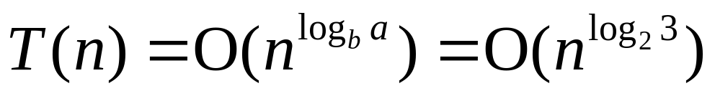
Master Theorem Example
Recall that complexity of fast multiply was:
T(n) = 3T(n/2) + Θ(n)
Thus, a=3, b=2, d=1. So a > b^{d}, so case 3 of the master theorem applies, so:
which is O(n^{1.58…}), so the new algorithm is strictly faster than ordinary Θ(n²) multiply!
26年 11月 8日
©2001-2004 Michael P. Frank, revised by S. Kang

